Slide 1
Windows Form
Presented by: Er.Sudan Prajapati

Slide 2
Introduction
The Windows Forms platform supports native Windows applications.
These applications have high-quality user experiences.
C# programmers have made extensive use of GUI to build user interfaces.
Each time Windows application created, Visual Studio will display a default blank form, onto which you can drag the controls onto your applications main form and adjust their size and position.

Slide 3
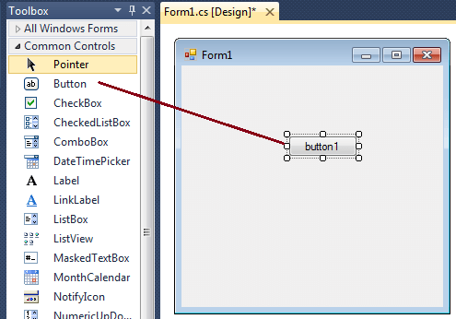

Slide 4
Creating Windows Form Application
The first step is to start a new project and build a form.
Open your Visual Studio and select File->New Project and from the new project dialog box select Other Languages->Visual C# and select Windows Forms Application.
Enter a project name at the bottom of the dialouge box and click OK button.
The picture in next slide shows how to create a new Form in Visual Studio.

Slide 5


Slide 6
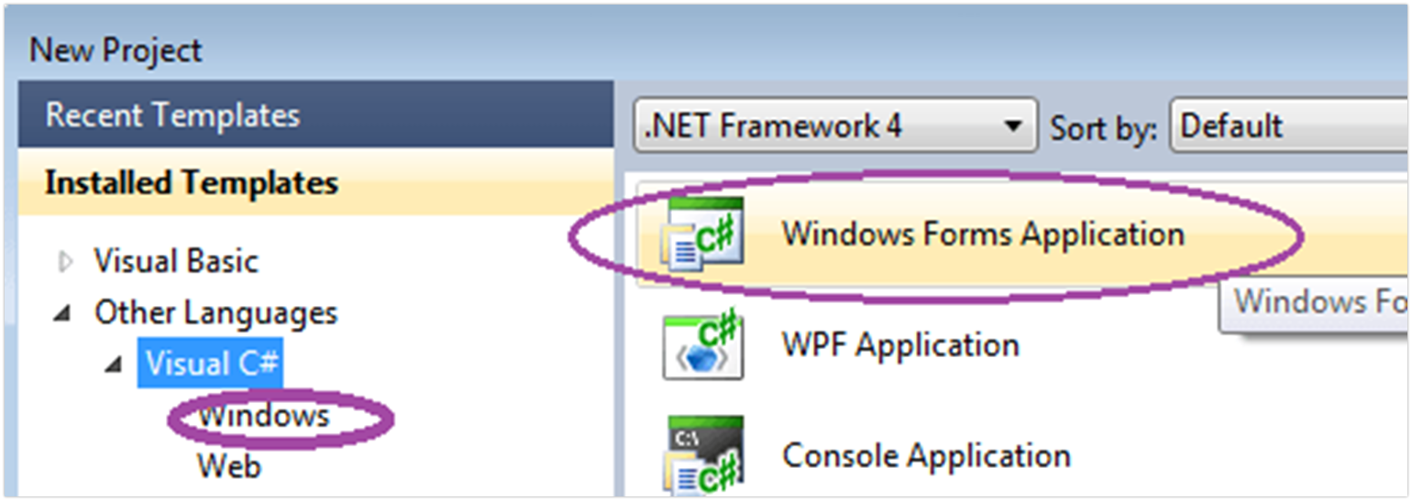
Creating Windows Form Application(contd)
Select Windows Forms Application from New Project dialog box.
After selecting Windows Forms Application , you can see a default Form (Form1) in your new C# project. The Windows Form you see in Designer view is a visual representation of the window that will open when your application is opened.

Slide 7
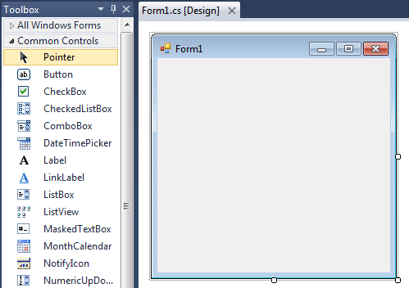
Creating Windows Form Application(contd)
You can switch between this view and Code view at any time by right-clicking the design surface or code window and then clicking View Code or View Designer.
The picture below shows how is the default Form (Form1) looks like.

Slide 8
Creating Windows Form Application(contd)
At the top of the form there is a title bar which displays the forms title.
Form1 is the default name, and you can change the name to your convenience .
The title bar also includes the control box, which holds the minimize, maximize, and close buttons.
If you want to set any properties of the Form, you can use Visual Studio Property window to change it.
If you do not see the Properties window, on the View menu, click Properties window.
This window lists the properties of the currently selected Windows Form or control, and its here that you can change the existing values.

Slide 9
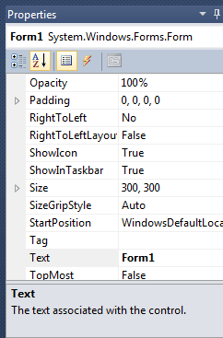
Creating Windows Form Application(contd)
To change the forms title from Form1 to MyForm, click on Form1 and move to the right side down Properties window, set Text property to MyForm.
Then you can see the Title of the form is changed.

Slide 10
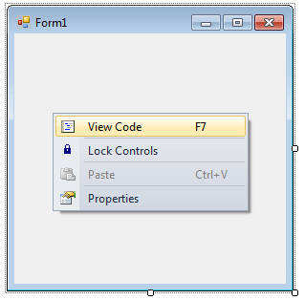
Creating Windows Form Application(contd)
You can also set the properties of the Form1 through coding.
For coding, you should right-click the design surface or code window and then clicking View Code.

Slide 11
Creating Windows Form Application(contd)
namespace WindowsFormsApplication1{
public partial class Form1 : Form {
public Form1() {
InitializeComponent(); }
private void Form1_Load(object sender, EventArgs e) {
this.Text = "Change Prperties Through Coding";
this.BackColor = Color.Brown;
this.Size = new Size(350, 125);
this.Location = new Point(300, 300);
this.MaximizeBox = false;
}
}
}

Slide 12
Displaying Messages Using the MessageBox
A message box is a small dialog box that displays a message to the user.
Message boxes are often used to tell the user the result of some action.
The MessageBox.Show() method can be used to tell a user something or ask the user a question.
In addition to text, which is its primary function, you can also use this function to display an icon or display one or more buttons that the user can click.
A MessageBox.Show() method is an overloaded method.

Slide 13
Try Out
private void button1_Click(object sender, EventArgs e) {
MessageBox.Show("7th sem is awesome.");
}
private void button2_Click(object sender, EventArgs e)
{
MessageBox.Show("7th sem is awesome.",
"Important Message");
}

